Slide 1




Predicting NCAA Outcomes
Ben Cohen Tim Kushmaro Omri Tzur

Slide 2
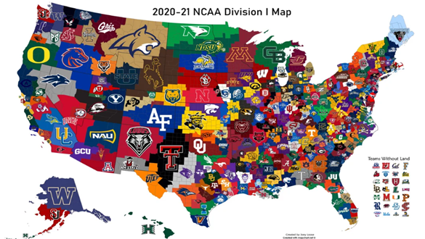
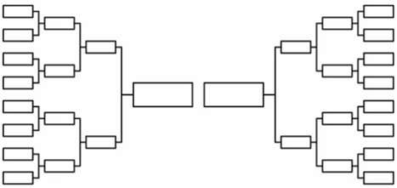
UNDERSTANDING THE TASK
Goal: Predict outcomes for the 2024 men’s and women’s NCAA tournaments.
Generate large numbers of probabilistic brackets (up to 100,000).
Evaluation:
- Brier Score: Measures the accuracy of probabilistic forecasts
2

Slide 3

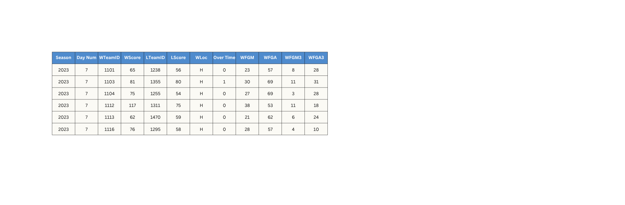
Dataset Composition:
- Regular Season Data: game results, locations, detailed stats.
- Tournament Data: seeds, slots, results and stats from previous tournaments.
- Additional Data: coaches, conferences, cities, ranking sources (ESPN, etc.).
- 2024 seeds included for both men & women.
OVERVIEW OF THE DATASET
Examples:
3

Slide 4


COMPACT VS. DETAILED GAME LOGS
Compact results (regular-season & tournament):
~8 core columns: season, day-number, winner / loser IDs & scores, home / away flag, overtime count.
Lightweight ⇒ perfect for fast win/loss features, Elo updates, and label generation.
Detailed results:
Same 8 columns plus ~30 box-score statistics (FGM, 3-pt attempts, rebounds, assists, turnovers, fouls, etc.).
Grows each row from ≈ 8 → ≈ 38 columns - nearly 5× richer.
Enables advanced features (shooting efficiency, possession-level metrics, defensive pressure).
Historical coverage:
Compact logs start with 1985 (M) / 1998 (W); detailed stats begin later (2003 M / 2010 W).
For our simpler models (fewer features), we leverage the larger, compact dataset. For our advanced models that (richer features), we train on the smaller but richer detailed dataset.
4

Slide 5
SEEDS, BRACKET MAPS & CONTEXT TABLES
Seeds & Slots:
Annual seed files give numeric seeding for every tournament team.
Slot files describe the fixed bracket wiring; we join these to build future-round match-ups.
Extra “2024 seeds” CSV is spliced in so the model can score this year’s games before they are played.
Season & DayNum timeline:
Each season has a “Day Zero” date; all games share a DayNum (0–154).
Lets us merge games, seeds, and external rankings without raw timestamps and keeps our rolling-window CV strictly forward-looking.
Men + Women under one roof:
File prefixes M* and W* keep genders separate; our loader can combine or isolate with a single flag, so we can train gender-specific models or a unified one.
5

Slide 6
Goal: Transform raw NCAA basketball data into model-ready features to predict tournament game outcomes.
Approach: A modular preprocessing pipeline that systematically engineers features and prepares data for modeling, with an emphasis on reusability and accuracy.
PREPROCESSING PIPELINE OVERVIEW
Key Features: Supports multiple model types, both detailed and compact datasets, implements season-aware processing, and incorporates advanced feature engineering (from basic seed differences to Elo ratings) to boost predictive power.
6

Slide 7
MODULAR DESIGN -KEY PREPROCESSING COMPONENTS
build_model_pipeline: Central orchestrator that reads season data, applies feature‐engineering steps, and outputs a training-ready dataset; fully configurable and extensible.
generate_matchup_matrix: Builds head-to-head feature rows for every team pair (stats, differences, seeds), reusable for both historical games and upcoming matchups.
rolling_window_cv: Performs temporal cross-validation by training on past seasons and testing on the next, preserving season order for realistic performance evaluation.
7

Slide 8
MULTI-MODEL SUPPORT VIA PARAMETERIZED INTERFACE
Flexible Modeling: Supports Logistic Regression, Random Forest, XGBoost, and Neural Networks via a single parameter or config setting—swap algorithms without touching the code.
Unified Interface: Applies identical preprocessing (feature engineering, scaling, etc.) so every model ingests data in the same format, whether it’s linear or non-linear.
Consistent Training: Uses one preprocessing pipeline and feature-computation process for all models, while allowing each algorithm to select its own relevant features, simplifying performance comparisons, enabling ensemble approaches, and eliminating duplicated prep logic.
8

Slide 9
MATCHUP AUGMENTATION & SYNTHESIS
Scalable & Reusable Pipeline: Incorporates built-in error checks, and modular helper functions for efficient preprocessing, easy debugging, and straightforward extension with new features or validation strategies.
Symmetrical Augmentation: Duplicate each game by swapping Team A / B and flipping the outcome - doubling samples and eliminating ordering bias.
Synthetic Matchups: Generate on-the-fly feature vectors for any two teams - even those that never met - using the same engineered stats (seed, Elo, win%, etc.).
9

Slide 10
Before jumping into predictive modeling, we wanted to better understand the game itself.
Our core question was: what truly separates winning teams in the NCAA tournament?
To answer that, we conducted Exploratory Data Analysis (EDA) on detailed game-level data — for both men’s and women’s tournaments — to identify performance-based patterns that correlate with game outcomes.
What Really Drives a Tournament Win?
EXPLORATORY DATA ANALYSIS
10

Slide 11
Theoretical Exploration
Before diving into code or modeling, we began with deep theoretical reflection and manual data review.
We asked ourselves:
Which columns are likely to correlate strongly with winning?
What is the right time range to train a model, given constant roster changes in college basketball?
Should features be built at the game level or season level?
Do a few top teams dominate the tournament year after year, while most others barely qualify?
These questions helped us shape our feature engineering strategy and define the scope of our analysis.
11

Slide 12
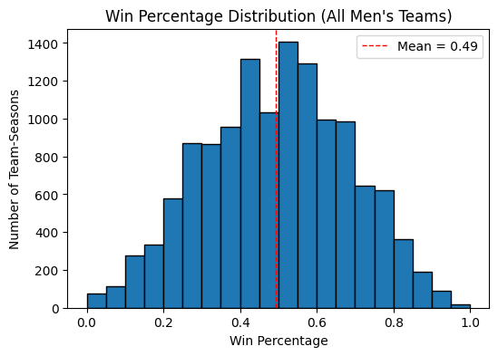
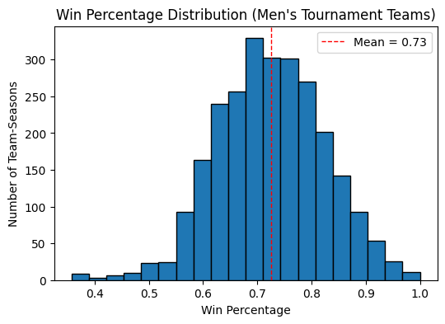
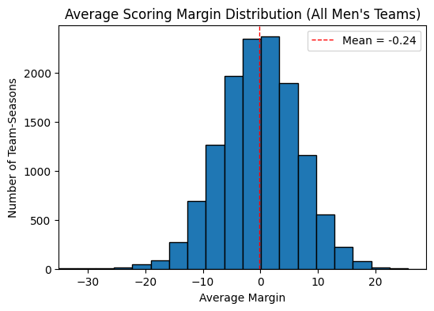
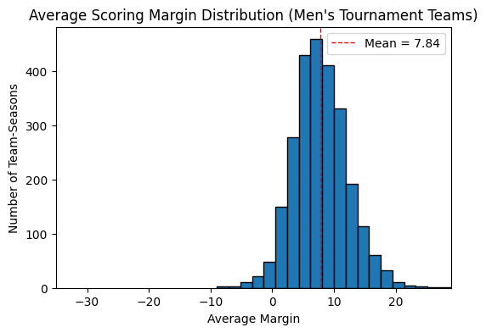
Tournament Team Profiles(Men’s Teams)
12

Slide 13
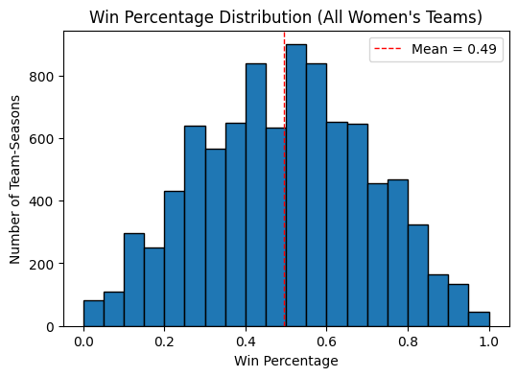
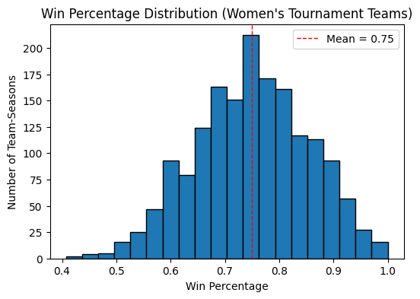
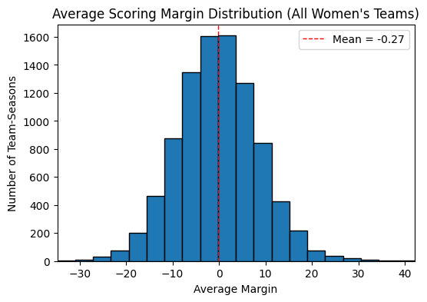
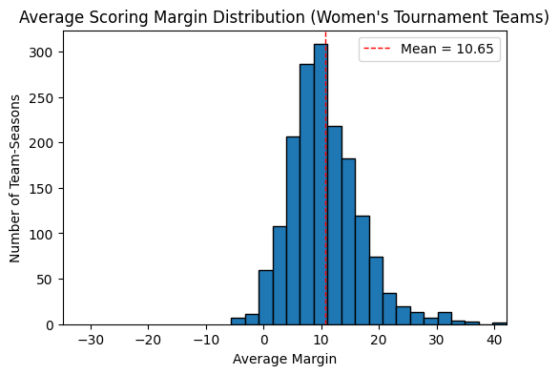
Tournament Team Profiles(Women’s Teams)
13

Slide 14
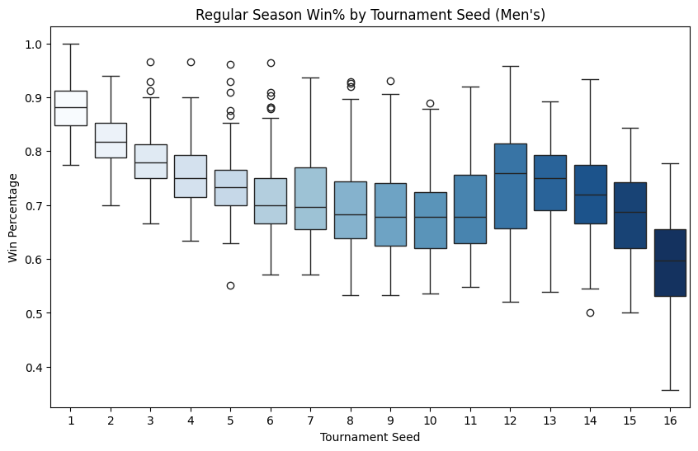
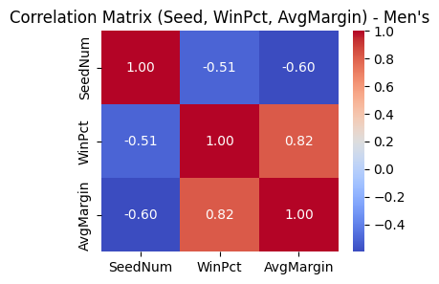
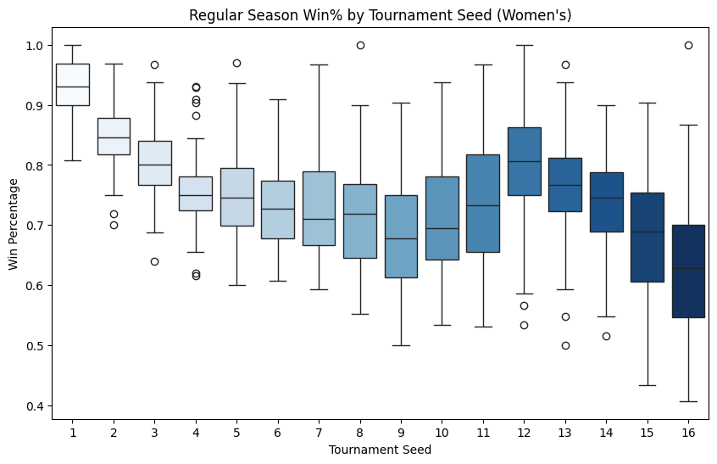
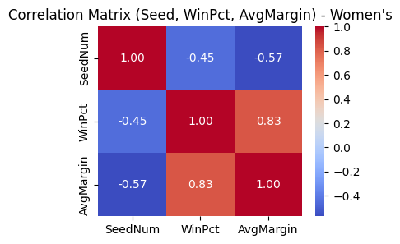
Seed, Win%, and Scoring Margin
14

Slide 15
Features Explored in EDA
Baseline Features:
Seed – Tournament seeding (initial ranking)
WinPct – Regular season win percentage
AvgMargin – Average scoring margin per game
In-Game Engineered Features:
AstDiff – Assist differential (team coordination)
TORDiff – Turnover differential (ball control)
FTADiff – Free throw attempt advantage
RebDiff – Rebound differential (possession edge)
ThreePtDiff – 3-point shooting efficiency gap
OffEff – Offensive efficiency (points per estimated possession)
FoulDiff – Foul differential (discipline & physicality)
Goal:
Each feature was analyzed in relation to the final score — and across genders — to uncover not just what wins games, but how winning behavior differs between men’s and women’s basketball.
15

Slide 16
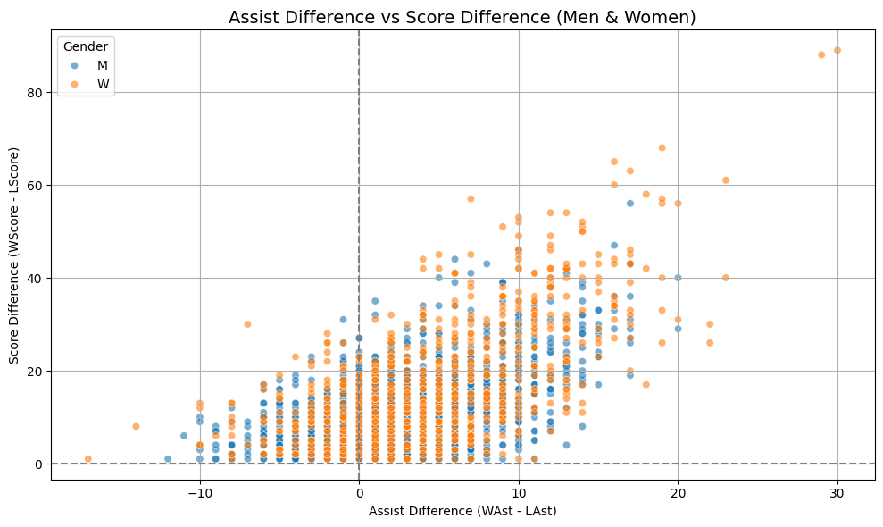
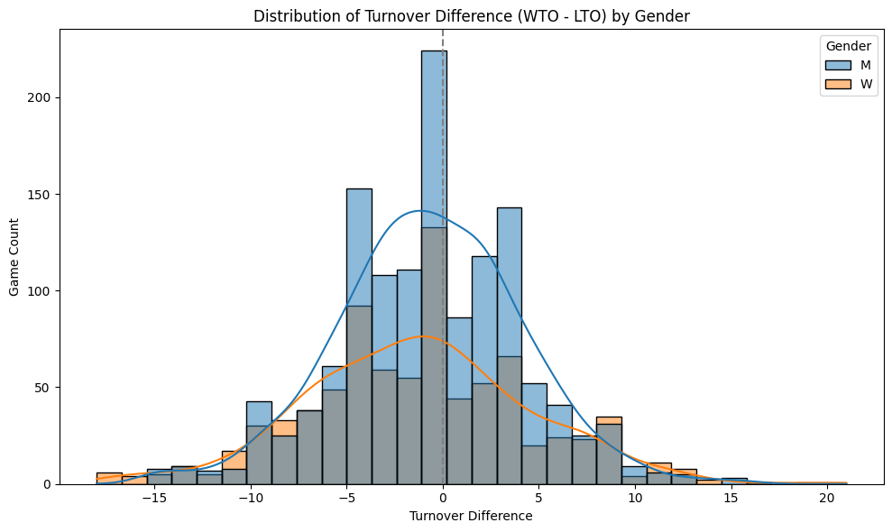
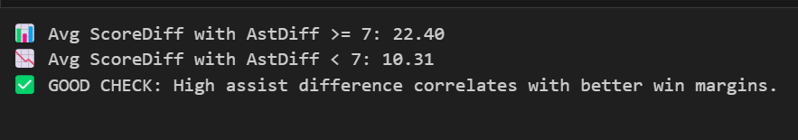
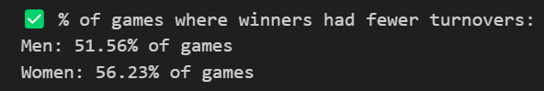
These features revealed useful insights about game dynamics, but were ultimately excluded from the model based on:
Conceptual overlap with stronger predictors (e.g., AstDiff vs. Offensive Efficiency)
Low or inconsistent separation from the outcome variable
Potential multicollinearity or redundancy
Assist Differential (AstDiff)
Turnover Differential (TORDiff)
16

Slide 17
Motivation: Chosen for its simplicity and interpretability.
Role: Provides an initial check on our features predictive power and a performance benchmark.
Approach: Start linear model to predict the chance of Team1 winning a matchup.
LOGISTIC REGRESSION
Our features for the model are based upon our compact games stats.
we preformed first initial check on baseline model which later on we compared our updated model evaluations to.
Add explanations here
17

Slide 18

LOGISTIC REGRESSION MODEL ANALYSIS
Stage | What we did | Why it mattered
Applied preprocessing | fetched and symmetrize the data, engineered and incorporated new features. | Proper work
Adding features | Computed EloDiff and appended Seed/WinPct/Margin differences. | Preforming feature engineering is crucial to capture indicative features
Lasso CV | Standardized all features with Standard Scaler and ran LassoCV to drop redundant predictors through L1 shrinkage. | The four core difference features (SeedDiff, WinPctDiff, AvgMarginDiff, EloDiff) kept non‑zero coefficients, confirming their importance.
RFE (LR & RF) | Performed Recursive Feature Elimination with both Logistic Regression and Random Forest to rank the selected features. | Made sure that WinpctDiff still contributes even though his coefficient is negative
SHAP | Ran SHAP analysis to visual‑check contributions. | Made sure our feature selection is proper and accurate
Weighted‑decay | Tried to find optimal lambda and incorporated weighted decay. | researched the posiability that we need to give more importance to recent years
Best Data-cut year | Performed a check to determine the best data cut-off year. | It was important to assess whether earlier seasons introduced irrelevant data and confirmed: more data improved performance.
Tune Hyperparameters | Used the Optuna library to find the optimal regularization strength (C) and penalty type (l1 or l2) for logistic regression. | Found optimal hyper-parameters to avoid overfitting
18

Slide 19
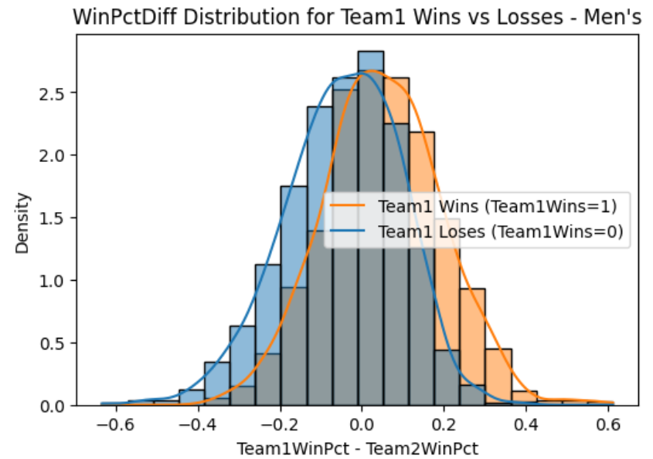
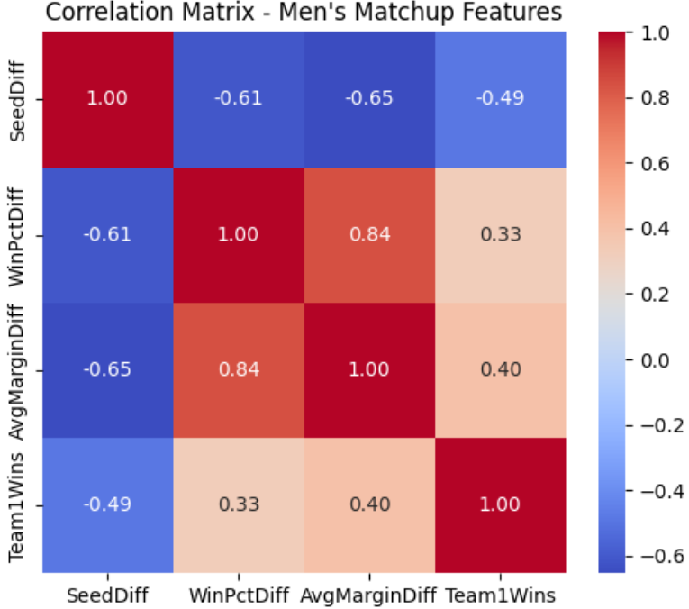
Our new incorporated difference features
19

Slide 20
LOGISTIC REGRESSION MODEL ANALYSIS
Stage | What we did | Why it mattered
Applied preprocessing | fetched and symmetrize the data, engineered and incorporated new features. | Proper work
Adding features | Computed EloDiff and appended Seed/WinPct/Margin differences. | Preforming feature engineering is crucial to capture indicative features
Lasso CV | Standardized all features with Standard Scaler and ran LassoCV to drop redundant predictors through L1 shrinkage. | The four core difference features (SeedDiff, WinPctDiff, AvgMarginDiff, EloDiff) kept non‑zero coefficients, confirming their importance
RFE (LR & RF) | Performed Recursive Feature Elimination with both Logistic Regression and Random Forest to rank the selected features. | Made sure that WinpctDiff still contributes even though his coefficient is negative
SHAP | Ran SHAP analysis to visual‑check contributions. | Made sure our feature selection is proper and accurate
Weighted‑decay | Tried to find optimal lambda and incorporated weighted decay. | researched the posiability that we need to give more importance to recent years
Best Data-cut year | Performed a check to determine the best data cut-off year. | It was important to assess whether earlier seasons introduced irrelevant data and confirmed: more data improved performance.
Tune Hyperparameters | Used the Optuna library to find the optimal regularization strength (C) and penalty type (l1 or l2) for logistic regression. | Found optimal hyper-parameters to avoid overfitting
20

Slide 21
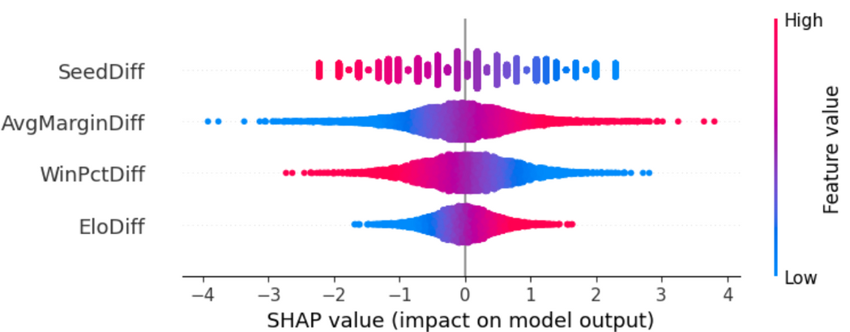
LassoCV (L1 Regularization)
Selected Features:
SeedDiff
WinPctDiff
AvgMarginDiff
EloDiff
Standardized all features with Standard Scaler and ran LassoCV to drop redundant predictors through L1 shrinkage.
Feature | Logistic Regression Ranking | Random Forest Ranking
WinPctDiff | Rank 1 | Rank 4
SeedDiff | Rank 2 | Rank 3
AvgMarginDiff | Rank 3 | Rank 1
EloDiff | Rank 4 | Rank 2
Performed Recursive Feature Elimination with both Logistic Regression and Random Forest to rank the selected features.
Ran SHAP analysis to visual‑check contributions:
21

Slide 22
LOGISTIC REGRESSION MODEL ANALYSIS
Stage | What we did | Why it mattered
Applied preprocessing | fetched and symmetrize the data, engineered and incorporated new features. | Proper work
Adding features | Computed EloDiff and appended Seed/WinPct/Margin differences. | Preforming feature engineering is crucial to capture indicative features
Lasso CV | Standardized all features with Standard Scaler and ran LassoCV to drop redundant predictors through L1 shrinkage. | The four core difference features (SeedDiff, WinPctDiff, AvgMarginDiff, EloDiff) kept non‑zero coefficients, confirming their importance
RFE (LR & RF) | Performed Recursive Feature Elimination with both Logistic Regression and Random Forest to rank the selected features. | Made sure that WinpctDiff still contributes even though his coefficient is negative
SHAP | Ran SHAP analysis to visual‑check contributions. | Made sure our feature selection is proper and accurate
Weighted‑decay | Tried to find optimal lambda and incorporated weighted decay. | researched the posiability that we need to give more importance to recent years
Best Data-cut year | Performed a check to determine the best data cut-off year. | It was important to assess whether earlier seasons introduced irrelevant data and confirmed: more data improved performance.
Tune Hyperparameters | Used the Optuna library to find the optimal regularization strength (C) and penalty type (l1 or l2) for logistic regression. | Found optimal hyper-parameters to avoid overfitting
22

Slide 23
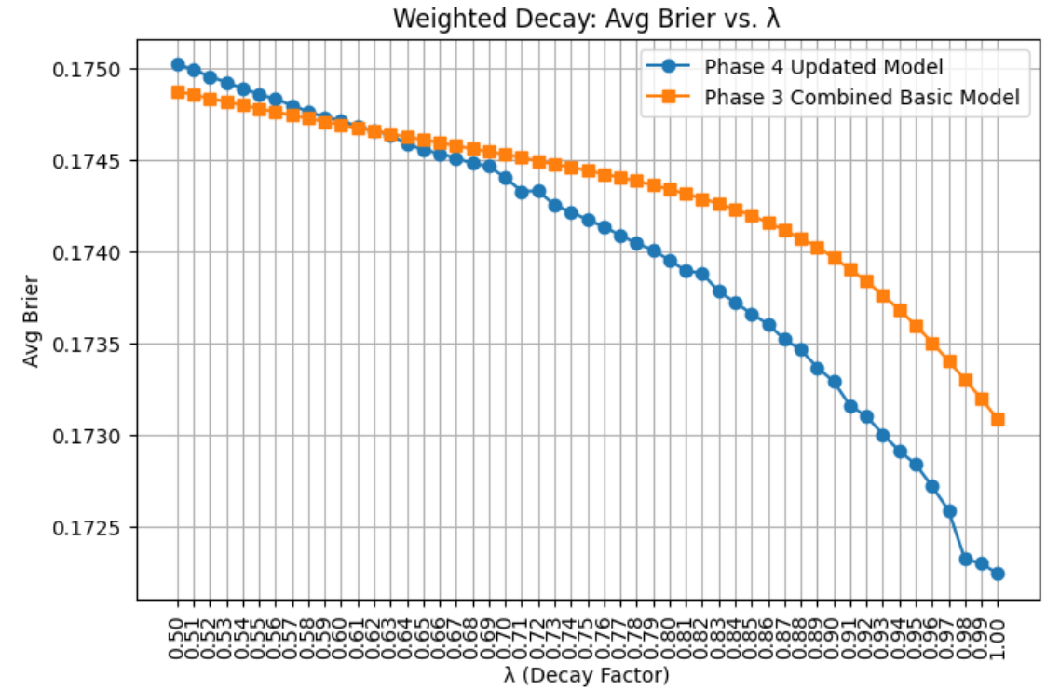
Incorporating a weighted decay mechanism did not lead to improvements in the Brier score for both of our models.
In this case, adding decay may introduce unnecessary complexity and nonlinearities without meaningful gain.
23

Slide 24
LOGISTIC REGRESSION MODEL ANALYSIS
Stage | What we did | Why it mattered
Applied preprocessing | fetched and symmetrize the data, engineered and incorporated new features. | Proper work
Adding features | Computed EloDiff and appended Seed/WinPct/Margin differences. | Preforming feature engineering is crucial to capture indicative features
Lasso CV | Standardized all features with Standard Scaler and ran LassoCV to drop redundant predictors through L1 shrinkage. | The four core difference features (SeedDiff, WinPctDiff, AvgMarginDiff, EloDiff) kept non‑zero coefficients, confirming their importance
RFE (LR & RF) | Performed Recursive Feature Elimination with both Logistic Regression and Random Forest to rank the selected features. | Made sure that WinpctDiff still contributes even though his coefficient is negative
SHAP | Ran SHAP analysis to visual‑check contributions. | Made sure our feature selection is proper and accurate
Weighted‑decay | Tried to find optimal lambda and incorporated weighted decay. | researched the posiability that we need to give more importance to recent years
Best Data-cut year | Performed a check to determine the best data cut-off year. | It was important to assess whether earlier seasons introduced irrelevant data and we confirmed: more data improved performance.
Tune Hyperparameters | Used the Optuna library to find the optimal regularization strength (C) and penalty type (l1 or l2) for logistic regression. | Found optimal hyper-parameters to avoid overfitting
24

Slide 25
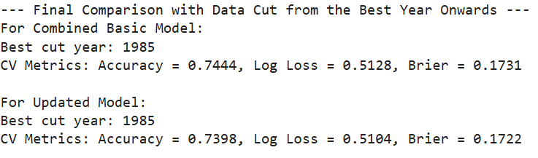

7. Best Data-cut year | Performed a check to determine the best data cut-off year. | It was important to assess whether earlier seasons introduced irrelevant data and confirmed: more data improved performance.
8. Tune Hyperparameters | Used the Optuna library to find the optimal regularization strength (C) and penalty type (l1 or l2) for logistic regression. | Found optimal hyper-parameters to avoid overfitting
Results:
Best Hyperparameters for Combined Basic Model: {'penalty': 'l2', 'C': 2.456434303645424}
Best Brier: 0.17214154534815712
Best Hyperparameters for Updated Model: {'penalty': 'l2', 'C': 8.421566623791172}
Best Brier: 0.17112664729699198
25

Slide 26
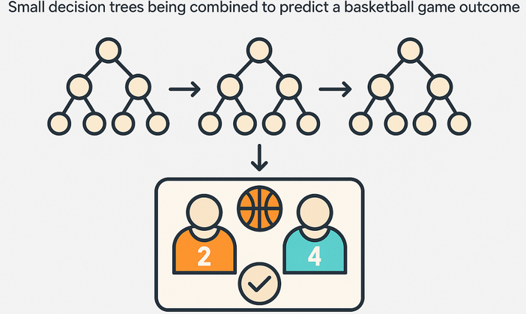
Motivation: We chose Random Forest
due to the facts:
it’s a fast, reliable model that performs well on structured data.
less sensitive to noise, handles well small datasets and can reveal which features are most important.
RANDOM FOREST
Our features for the model are based upon our compact games stats.
26

Slide 27
RANDOM FOREST
Stage | What we did | Why it mattered
Feature Engineering and preprocessing | we used more stats like numbers of games played which are non trivial. Built matchup‑level features: difference features, and engineered special features like Last14WinRateDiff and NeutralWinRateDiff. All symmetrized. | Captured each team’s relative strength considering Last14WinRateDiff to incorporate momentum and NeutralWinRateDiff to see the performance of the team in; symmetrization eliminated bias from team order.
Feature Selection | Forward‑added features or feature pairs only if they lowered Brier score, with safeguards (add, drop‑retest, add‑top‑3) to escape local minima. | Guaranteed we kept only signal boosting stats and found near optimal model settings without overfitting.
Model Tuning | Used Optuna to tune number of trees, depth, and sample splits. | Automated search found near optimal settings.
Performance | Achieved ≈ 73 % accuracy and Brier ≈ 0.173; trained ~15× faster than XGBoost. | Confirmed our feature choices and let us iterate rapidly; strong speed‑to‑performance ratio.
27

Slide 28
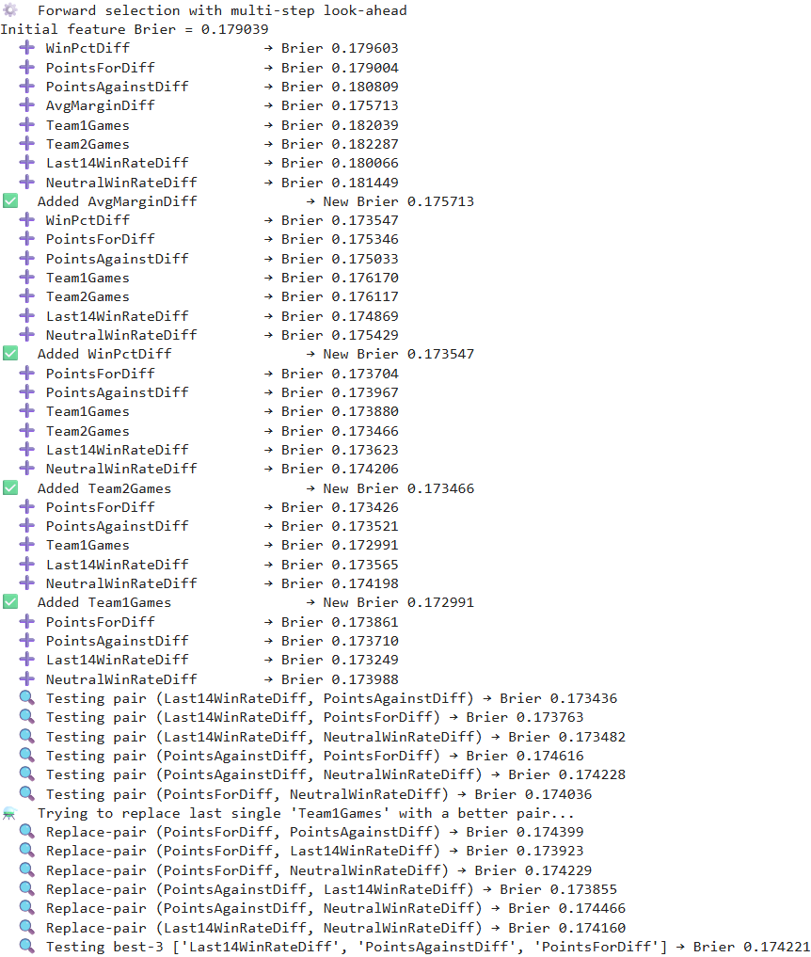
Feature Selection and Optimization.
Similarly to the XGBoost.
At each iteration:
We added the single feature that yielded the largest reduction in Brier score under rolling-window cross-validation.
If we didn't improve we tried to add pairs of features together.
Otherwise, to avoid local minima, we removed the most recently included feature and re-evaluated the top pairs
Otherwise, checked by adding the three most indicative features together.
This cycle continued until no further features reduced the Brier score beyond our predefined threshold.
28

Slide 29
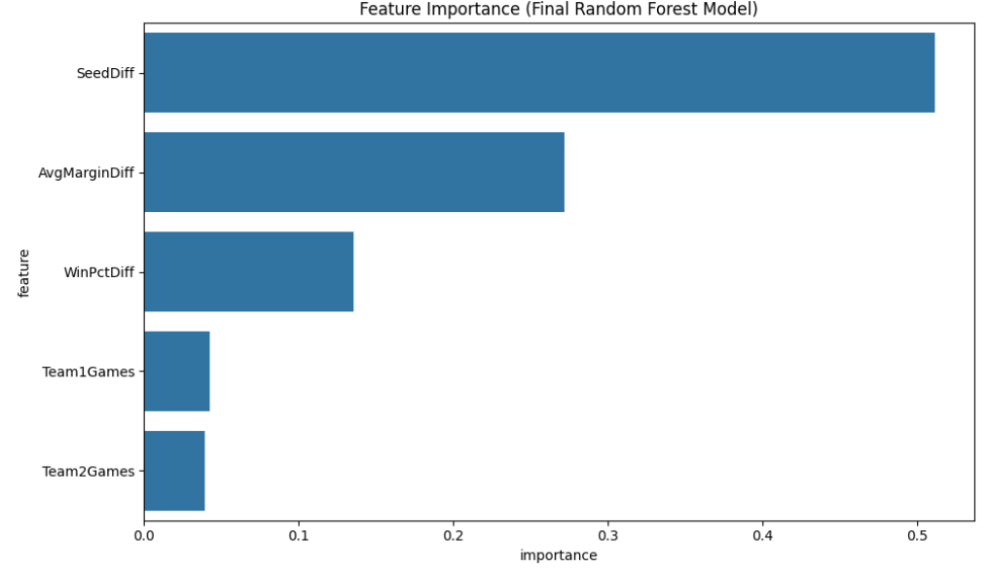
Results
Our most important features:
SeedDiff 0.511106
AvgMarginDiff 0.271625
WinPctDiff 0.135290
Team1Games 0.042462
Team2Games 0.039517
Final evaluation using all available training data on our test set:
Season 2011 – Accuracy: 0.692, Log Loss: 0.511, Brier: 0.176
Season 2012 – Accuracy: 0.765, Log Loss: 0.509, Brier: 0.167
Season 2013 – Accuracy: 0.712, Log Loss: 0.537, Brier: 0.184
Season 2014 – Accuracy: 0.735, Log Loss: 0.514, Brier: 0.176
Season 2015 – Accuracy: 0.781, Log Loss: 0.464, Brier: 0.150
Season 2016 – Accuracy: 0.731, Log Loss: 0.533, Brier: 0.180
Season 2017 – Accuracy: 0.792, Log Loss: 0.490, Brier: 0.164
Season 2018 – Accuracy: 0.692, Log Loss: 0.557, Brier: 0.188
Season 2019 – Accuracy: 0.738, Log Loss: 0.460, Brier: 0.155
Season 2021 – Accuracy: 0.705, Log Loss: 0.570, Brier: 0.194
Overall average metrics: Accuracy: 0.734, Log Loss: 0.515, Brier: 0.173
29

Slide 30
Motivation:
Designed for tabular data: XGBoost excels on heterogeneous, tabular features and captures non-linear relationships.
Regularized & robust: Built-in regularization (shrinkage, tree depth limits) helps prevent overfitting on our limited NCAA dataset.
Accurate probabilities: Produces well-calibrated win probabilities, ideal for predicting single elimination game outcomes.
XGBOOST
Our features for the model are based upon our Detailed games stats.
30

Slide 31
Stage | What we did | Why it mattered
Raw feature construction | Computed 45 matchup‑level features: season‑long box‑score differentials (points, 3‑pt %, rebounds, assists, turnovers), momentum (last‑14‑day win %), seed gap, plus advanced metric ( GLM “true strength” diff). conducted symmetrization. | Captured both basic and subtle performance signals in a uniform, symmetric format, giving the model rich non‑linear information to learn from including 45 features.
Initial XGBoost draft + SHAP ranking + Forward Feature Selection (FFS) | 1. an initial XGBoost model, ranked features by mean absolute SHAP value, kept the top‑10. 2. filtered the only features that has correlation smaller than 0.85. 3. Conducted FFS on top of the filtered top 10 features we already selected. | Objectively identified the most influential predictors. We dropped highly correlated features (|ρ| > 0.85) to prevent redundancy, reduce overfitting, and ensure the model learns distinct, non-duplicative signals. Applying the exact FFS we used in the random forest to ensure a consistent and fair feature set across models
Hyperparameter tuning | Conducted comprehensive Grid-Search over the XGBOOST Hyperparameter | Balances bias–variance, preventing overfit on a moderate‑sized dataset.
Probability calibration | Fitted a spline calibrator capturing the relation between probabilities and the actual outcomes; isotonic/Platt gave no gain, so logistic kept. | Ensures predicted 70 % wins really occur ≈70 % of the time -crucial for probabilistic bracket scoring.
Performance validation | Average Brier of 0.176 and accuracy 72.7 % | Demonstrated that the tuned, updated model generalises and beats simpler baselines.
31

Slide 32
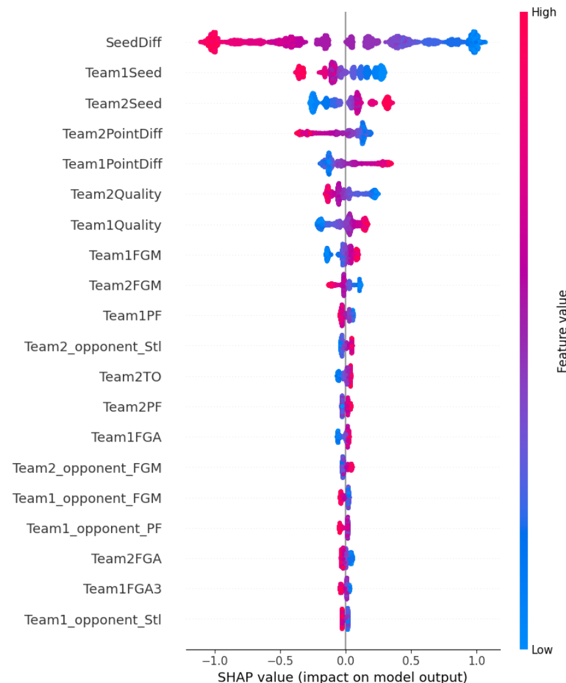
Selected Top 10 Features (with corr < 0.85):
SeedDiff: 0.587624
Team1Seed: 0.174508
Team2Seed: 0.166392
Team2PointDiff: 0.143315
Team1PointDiff: 0.139749
Team2Quality: 0.095355
Team1Quality: 0.093848
Team1FGM: 0.053011
Team2FGM: 0.046961
Team1PF: 0.031716
32

Slide 33

Final 13 features after FFS:
Selected Top 10 Features (with corr < 0.85):
SeedDiff: 0.587624
Team1Seed: 0.174508
Team2Seed: 0.166392
Team2PointDiff: 0.143315
Team1PointDiff: 0.139749
Team2Quality: 0.095355
Team1Quality: 0.093848
Team1FGM: 0.053011
Team2FGM: 0.046961
Team1PF: 0.031716
FFS selected features: Team1_opponent_FGM, Team2_opponent_FGM, Team2_opponent_Ast
33

Slide 34
Stage | What we did | Why it mattered
Raw feature construction | Computed 45 matchup‑level features: season‑long box‑score differentials (points, 3‑pt %, rebounds, assists, turnovers), momentum (last‑14‑day win %), seed gap, plus advanced metric ( GLM “true strength” diff). conducted symmetrization. | Captured both basic and subtle performance signals in a uniform, symmetric format, giving the model rich non‑linear information to learn from including 45 features.
Initial XGBoost draft + SHAP ranking + Forward Feature Selection (FFS) | Trained an initial XGBoost model, ranked features by mean absolute SHAP value, kept the top‑10. filtered the only features that has correlation smaller than 0.85. Conducted FFS on top of the filtered top 10 features we already selected. | Objectively identified the most influential predictors. We dropped highly correlated features (|ρ| > 0.85) to prevent redundancy, reduce overfitting, and ensure the model learns distinct, non-duplicative signals. Applying the exact FFS we used in the random forest to ensure a consistent and fair feature set across models
Hyperparameter tuning | Conducted comprehensive Grid-Search over the XGBOOST Hyperparameter | Balances bias–variance, preventing overfit on a moderate‑sized dataset.
Probability calibration | Fitted a spline calibrator capturing the relation between probabilities and the actual outcomes; isotonic/Platt gave no gain, so logistic kept. | Ensures predicted 70 % wins really occur ≈70 % of the time -crucial for probabilistic bracket scoring.
Performance validation | Average Brier of 0.176 and accuracy 72.7 % | Demonstrated that the tuned, updated model generalises and beats simpler baselines.
34

Slide 35
Hyperparameter | Values Tested | Role & Why We Chose These Ranges
max_depth | 3, 4 | Limits tree depth to keep trees shallow so they learn only the strongest splits and avoid overfitting on our moderate‐sized dataset.
learning_rate | 0.065, 0.05, 0.035, 0.02 | Controls step size in boosting.
min_child_weight | 30, 40, 50 | Requires a minimum sum of instance weights in a leaf. High values (30–50) prevent splits on small or noisy segments, reducing overfit.
gamma | 10, 20 | Minimum loss reduction to make a further split. Larger gamma (10–20) means only highly beneficial splits are allowed, pruning weak branches.
subsample | 0.35, 0.50 | Fraction of rows sampled per tree. Values ≤ 0.5 inject randomness, diversify trees, and combat over-reliance on any single subset.
colsample_bytree | 0.70, 0.80 | Fraction of features sampled per tree. Sampling 70–80% of features reduces multicollinearity risk and improves robustness against noisy predictors.
penalty | 0, 1e-4, 1e-3 | Penalty term on leaf weights.
35

Slide 36
Stage | What we did | Why it mattered
Raw feature construction | Computed 45 matchup‑level features: season‑long box‑score differentials (points, 3‑pt %, rebounds, assists, turnovers), momentum (last‑14‑day win %), seed gap, plus advanced metric ( GLM “true strength” diff). conducted symmetrization. | Captured both basic and subtle performance signals in a uniform, symmetric format, giving the model rich non‑linear information to learn from including 45 features.
Initial XGBoost draft + SHAP ranking + Forward Feature Selection (FFS) | Trained an initial XGBoost model, ranked features by mean absolute SHAP value, kept the top‑10. filtered the only features that has correlation smaller than 0.85. Conducted FFS on top of the filtered top 10 features we already selected. | Objectively identified the most influential predictors. We dropped highly correlated features (|ρ| > 0.85) to prevent redundancy, reduce overfitting, and ensure the model learns distinct, non-duplicative signals. Applying the exact FFS we used in the random forest to ensure a consistent and fair feature set across models
Hyperparameter tuning | Conducted comprehensive Grid-Search over the XGBOOST Hyperparameter | Balances bias–variance, preventing overfit on a moderate‑sized dataset.
8. Probability calibration | Fitted a spline calibrator capturing the relation between probabilities and the actual outcomes; isotonic/Platt gave no gain, so logistic kept. | Ensures predicted 70 % wins really occur ≈70 % of the time -crucial for probabilistic bracket scoring.
9. Performance validation | Average Brier of 0.176 and accuracy 72.7 % | Demonstrated that the tuned, updated model generalises and beats simpler baselines.
36

Slide 37
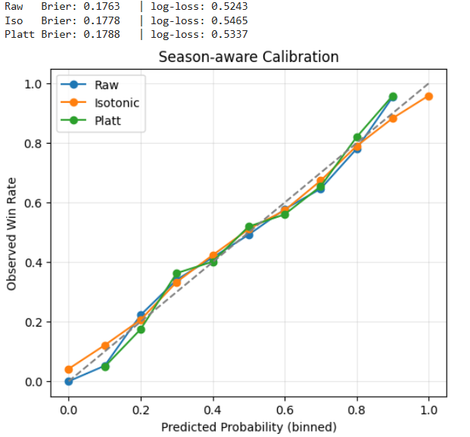
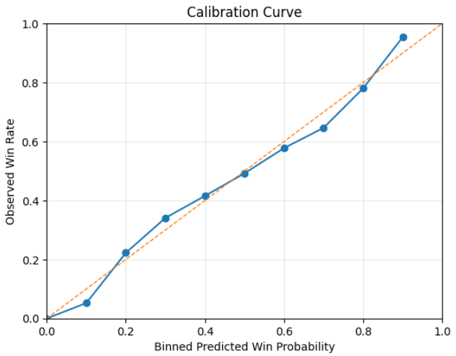
Final model results on the test set:
Using all features:
LogLoss 0.525122
Accuracy 0.729776
Brier 0.176683
Using selected features:
LogLoss 0.524372
Accuracy 0.727478
Brier 0.176329
37

Slide 38
Motivation: Selected to explore a non-linear modeling approach capable of capturing complex feature interactions.
Role: Serves as an advanced model to benchmark the effectiveness of deep learning versus traditional methods.
Approach: Trained a feedforward neural network with one hidden layer and dropout regularization to predict the probability of Team1 winning.
Add explanations here
NEURAL NETWORKS
Our features for the model are normalized and based on compact game statistics, such as win percentages, seed difference, and team quality.
We trained and tuned the network using Hyperband to find the best dropout rate, and evaluated its performance on held-out seasons.
38

Slide 39
NEURAL NETWORKS MODEL ANALYSIS
Stage | What we did | Why it mattered
Data Preparation | Filled missing values, removed Season, standardized features, and selected 7 informative features (e.g., SeedDiff, EloDiff). | Prepared clean and scaled inputs, reduced noise, and focused learning on the most relevant indicators.
Model Architecture Design | Built a shallow feedforward neural network with 1 hidden layer (16 ReLU units), dropout, and sigmoid output. | Enabled the model to capture non-linear patterns in a compact and efficient structure.
Dropout Regularization | Added a tunable dropout layer (10%–30%) between hidden and output layers. | Prevented overfitting and improved the network’s ability to generalize to unseen data.
Hyperparameter Tuning with Hyperband | Used Keras Tuner to automatically find the best dropout rate based on validation loss. | Optimized the regularization strength using systematic search instead of manual tuning.
Training Optimization (EarlyStopping + Class Weights) | Used EarlyStopping (patience=10) and class weighting to handle imbalance in win/loss labels. | Prevented overfitting and ensured the model treated both classes fairly during training.
Final Model Training | Trained the model with tuned parameters and evaluated it using a validation spli | Yielded a fully trained model ready for test-time performance measurement.
Test Evaluation & Calibration | Predicted on the test set, computed accuracy, log loss, Brier score, and plotted calibration curve. | Assessed both prediction accuracy and the trustworthiness of the probability estimates.
Cross-Validation and Strategy Comparison | Performed rolling-window cross-validation (2011–2022), and compared training strategies (all, last5, last1) to see how data history affects performance. | Revealed how training on more recent vs. full historical data impacts predictive accuracy across seasons, helping choose the best modeling approach.
39

Slide 40
Model Architecture & Training
Architecture:
Feedforward Neural Network
• Input layer: 7 features
• Hidden layer: 16 units, ReLU activation
• Dropout layer
• Output layer: 1 unit, Sigmoid activation (for binary classification)
Optimizer:
Adam (learning rate = 0.001)
Loss Function:
Binary Cross-Entropy, with weighted classes
Training Settings:
• Epochs: Up to 100 (EarlyStopping with patience = 10)
• Batch size: 32
• Validation split: 20% of training data used for validation
Regularization:
• L2 kernel regularization on the hidden layer (λ = 1e-4)
• Dropout (0.1–0.3) to reduce overfitting
• EarlyStopping to avoid unnecessary training
40

Slide 41
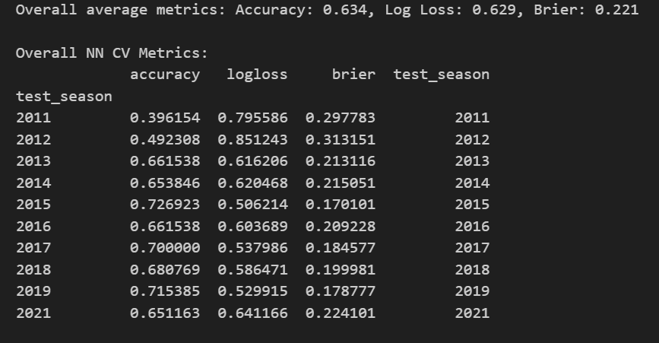
Cross-Validation Summary (2011–2021)
 | logistic regression | XGboost | Random Forest | Neural Networks
log-loss | 0.5128 | 0.5243 | 0.515 | 0.629
accuarcy | 0.7444 | 0.7727 | 0.734 | 0.634
brier | 0.1731 | 0.176 | 0.173 | 0.221
41
Conclusion:
The neural network did not outperform
our simpler baseline models
in either accuracy or probabilistic calibration.

Slide 42
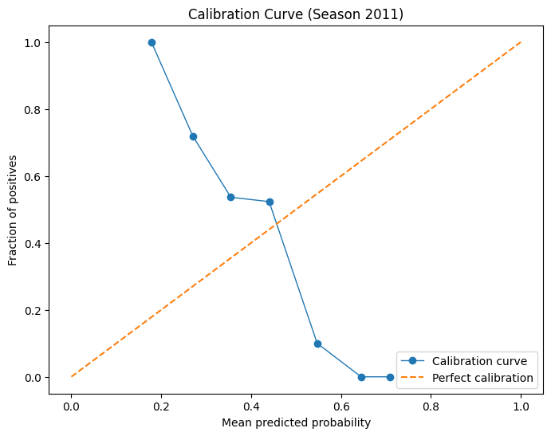
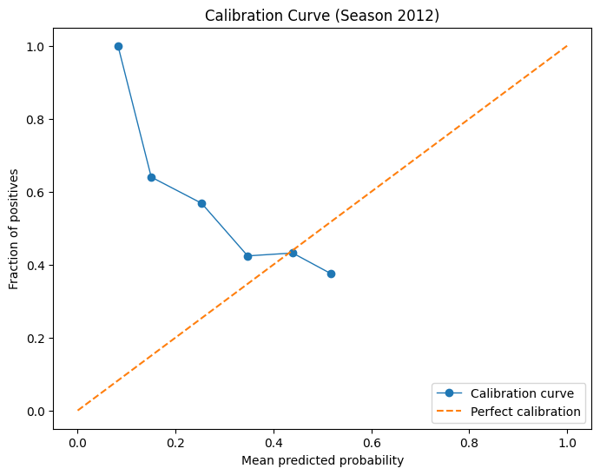
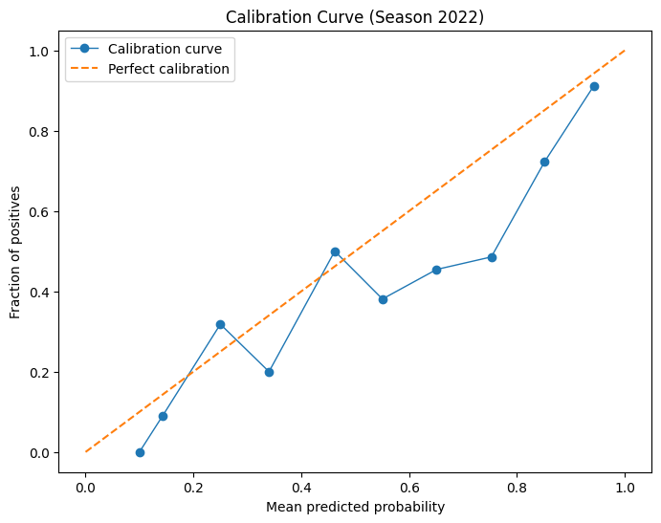
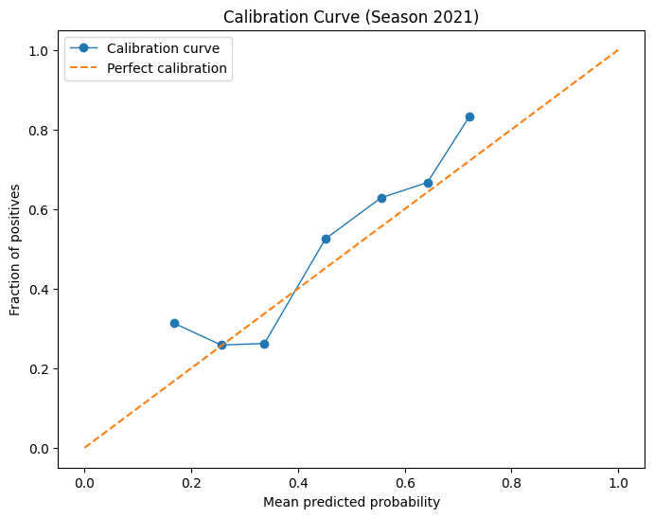
Calibration Analysis -Neural Network Across Seasons
• The calibration of the neural network model improved over time, as more historical data became available.
• Early seasons (e.g., 2012) show poor calibration, likely due to limited training data.
• In later seasons (e.g., 2021), the model’s probability estimates became more aligned with actual outcomes.
Despite this improvement, the neural network remained less calibrated and less consistent than simpler models like Logistic Regression or Random Forest.
Conclusion:
Due to its higher sensitivity to data volume and lower overall reliability, we did not include the neural network model in our final ensemble.
42

Slide 43
Objective: Minimise Brier score by delivering well-calibrated win probabilities.
Model characteristics:
Logistic Regression: linear, naturally calibrated, limited interactions
Random Forest: bagging reduces bias a bit, but votes land on coarse steps
XGBoost: rich non-linear signal, tends toward over-confidence in the tails
Motivation:
No single model balances sharpness and calibration
Weighted average can keep XGBoost’s detail and damp extreme probabilities with Logistic Regression’s caution
Random Forest adds diversity only if weight search proves useful
ENSEMBLE OVERVIEW & MOTIVATION
43

Slide 44
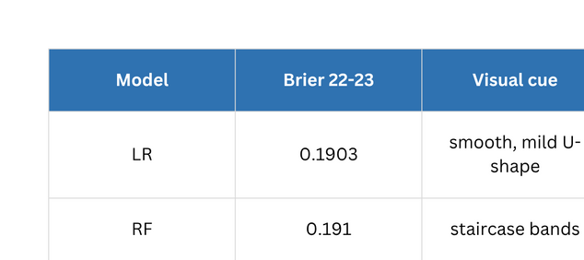
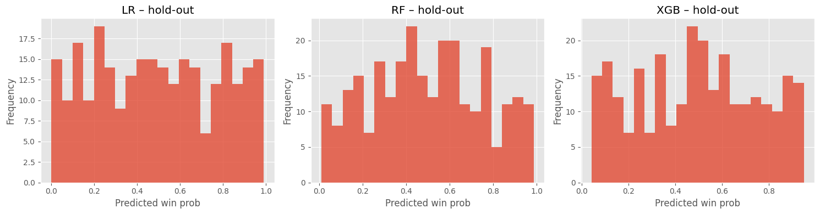
HOW WELL ARE SINGLES CALIBRATED?
44

Slide 45
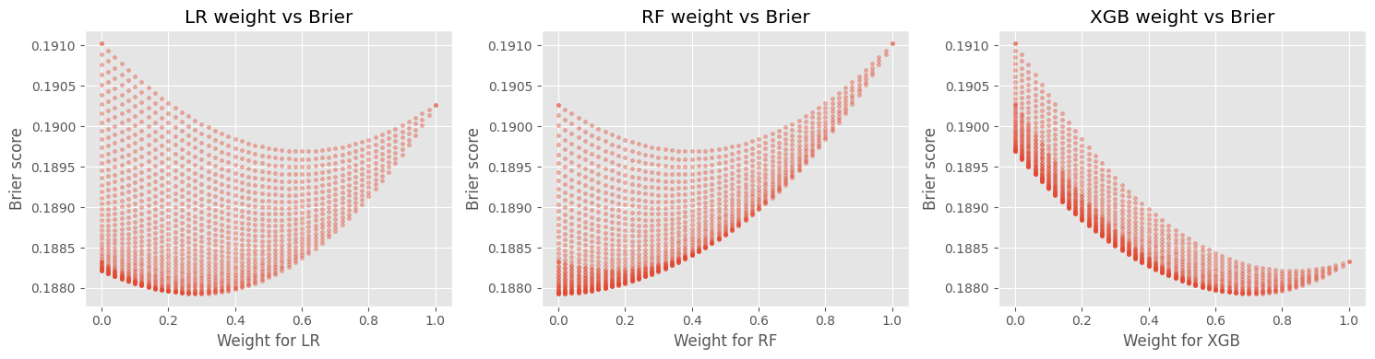
WEIGHT SEARCH AND WHY RF DROPS OUT
Grid step 0.02 across simplex: 8,000 blends
Optimal: 0.30 LR - 0.70 XGB - 0 RF
Ensemble Brier: 0.18793 (-0.21% vs XGB)
Interpretation:
LR weight 0.30 pulls back XGB’s over-confident edges
RF weight 0: its residual information is already captured, its voting noise now only adds variance.
Grid search valley sits exactly on RF = 0, showing RF adds mostly noise once LR+XGB are present.
45

Slide 46
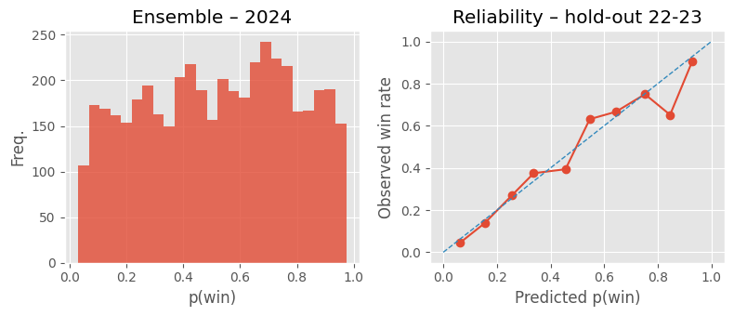
FINAL BLEND: WHAT CHANGED?
Left: 2024 probabilities show healthy coverage across the full 0-to-1
Right: 10-bin reliability (22-23 hold-out) hugs the 45° diagonal
Max deviation ≈ 1.4 percentage points → well-calibrated.
Extreme spikes from raw XGBoost are gone, sharpness retained, variance tamed
46

Slide 47
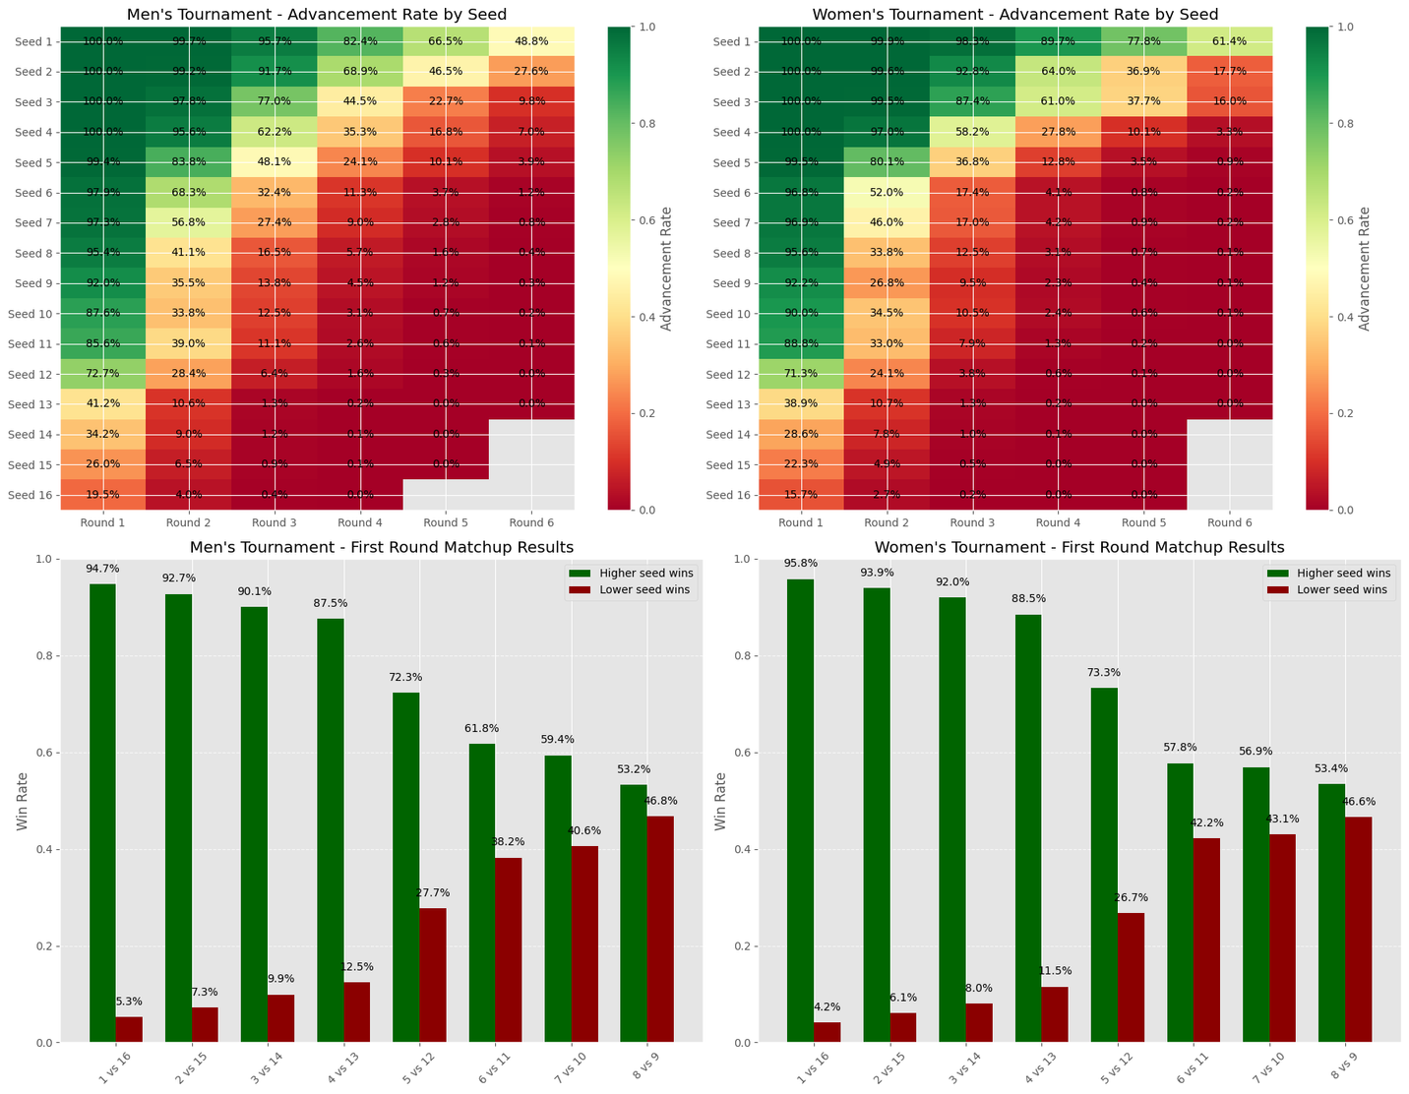
SAMPLING BRACKETS WITH REALISM CONTROLS
Attach ensemble P(win) to seed pairs (2024)
Draw 50k brackets for men, 50k for women (Monte-Carlo)
After sampling, block historically implausible results:
Seeds 13-16 stop at Sweet 16
Seed 12 stops at Elite 8
Seeds 8-11 stop at Final Four
Calibration intact - clipping occurs after scoring
47

Slide 48
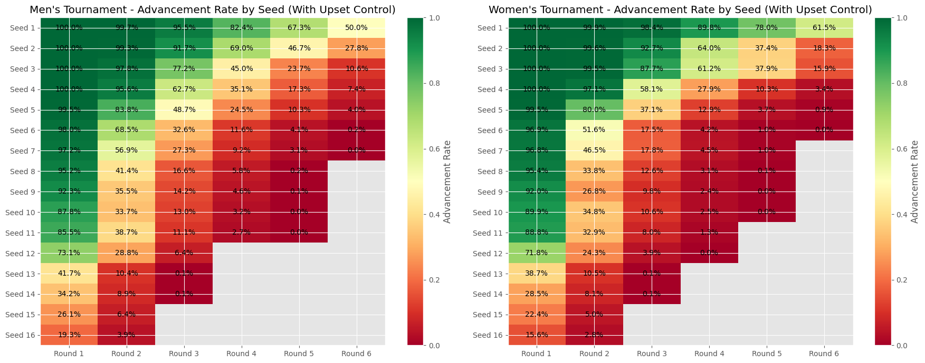
REALISM CONTROLS - RESULTS
48

Slide 49
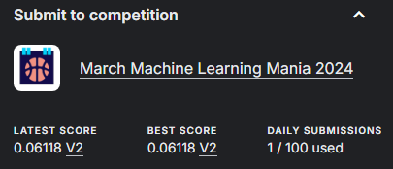
FINAL RESULTS
Achieved an overall score of 0.06118 by competition metrics, which ranked us in the top 150.
Note: Per-game Brier shown were previously shown. Kaggle’s “Average Brier Bracket Score” is just a rescaled version (~⅓ of this value), so minimising one minimises the other.
Ensemble keeps LR interpretability + XGB power, RF confirmed redundant
Bracket portfolio now matches historic upset frequencies
49

Slide 50
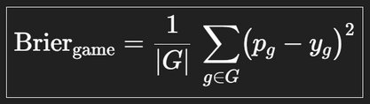
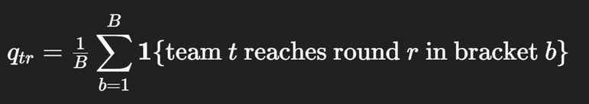
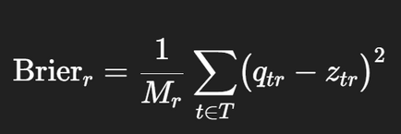
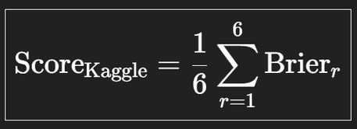
COMPETITON METRICS - EXPLAINED
1. Per-game Brier (what we optimise)
2. Competition Average Brier Bracket Score
Step A - Convert the portfolio into per-team probabilites
G = all real tournament games in the training split (≈63 per season)
p_g = predicted win probability for the team labelled “Team 1”
y_g​ = 1 if “Team 1” wins, else 0
Step B - Brier per round
Step C - Final Score
3. Why the scores land on different scales
1. Equation (2) spreads the same squared errors over 126 team–round cells instead of 63 games ⇒ ≈ ½.
2. Averaging across six rounds (× ⅙) shrinks again ⇒ ≈ ⅓.
3. Portfolio averaging (𝑞ₜᵣ) clips extreme 0/1 errors.
Hence 𝑆𝑐𝑜𝑟𝑒(kaggle) ≈ 0.3 × 𝐵𝑟𝑖𝑒𝑟𝗀𝖺𝗆𝖾.
• 𝐵 = number of brackets in your portfolio
• 𝑇 = the 64 tournament teams (per gender)
• 𝑧ₜᵣ = 1 / 0 indicator that team 𝑡 really reached round 𝑟
• 𝑀ᵣ = number of possible teams in round 𝑟
(64, 32, 16, 8, 4, 2)
50

Slide 51



KEY INSIGHTS & TAKE-AWAYS
Feature engineering trumped raw model choice – the four diff-features (Seed, Win %, Margin, Elo) explained > 80 % of LR signal and transferred to tree models.
Calibration focus paid off – enforcing reliable probabilities cut per-game Brier by ~1.4 pp and boosted bracket realism.
Simple + complex works – a 0.30 LR / 0.70 XGB blend outperformed either model alone and removed RF noise.
Rolling-window CV prevented hindsight bias - back-tests on 2022-23 mirrored real-world 2024 results.
Purely self-contained data still secured rank 141/1600 (~top 9 %) – proving historical information alone is competitive.

Slide 52
POTENTIAL ENHANCEMENTS FOR 2026
Nate Silver (538) power ratings – subscription-only predictor of possession-level efficiency; top teams blended it 1-for-1 with ML.
Real-time injury & availability feeds – scrape beat-writer reports or use Sportradar; adjust Elo prior to tournament.
52

